Slide 1
Random Forest for ENAC-Len-5

Slide 2
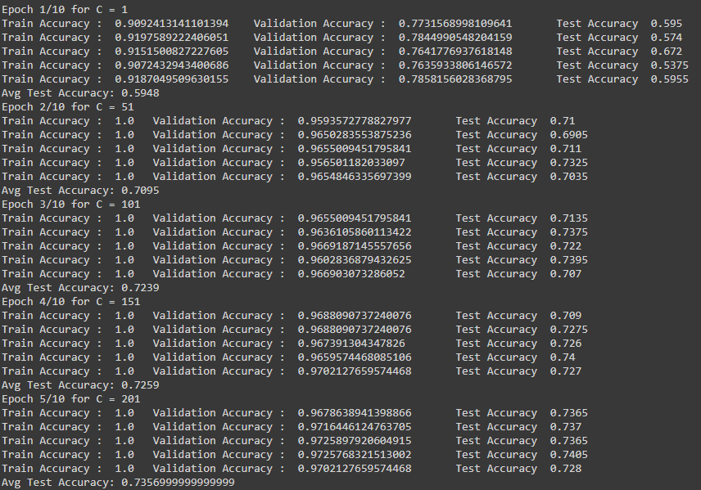
Step 1
n_estimators = variable
max_depth = none
Range 1 to 452

Slide 3
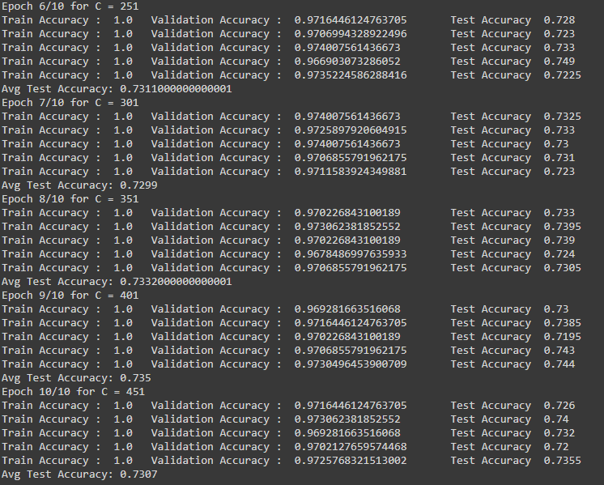
Step 1
n_estimators = variable
max_depth = none
Range 1 to 452

Slide 4
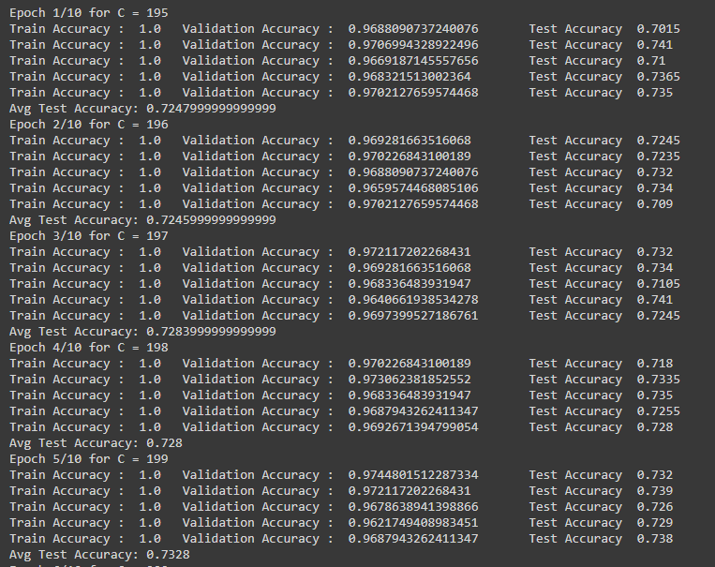
Step 2
n_estimators = variable
max_depth = none
Range 195 to 205

Slide 5
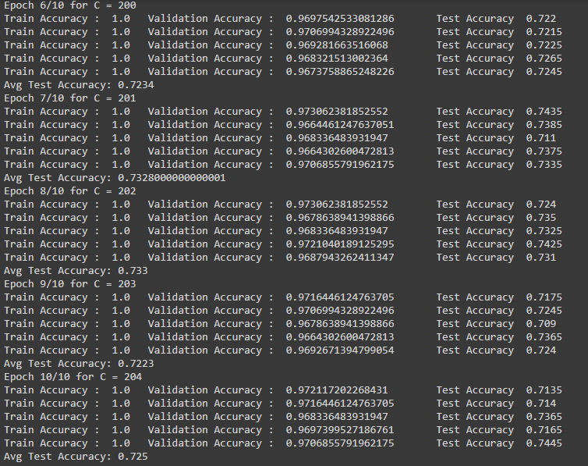
Step 2
n_estimators = variable
max_depth = none
Range 195 to 205

Slide 6
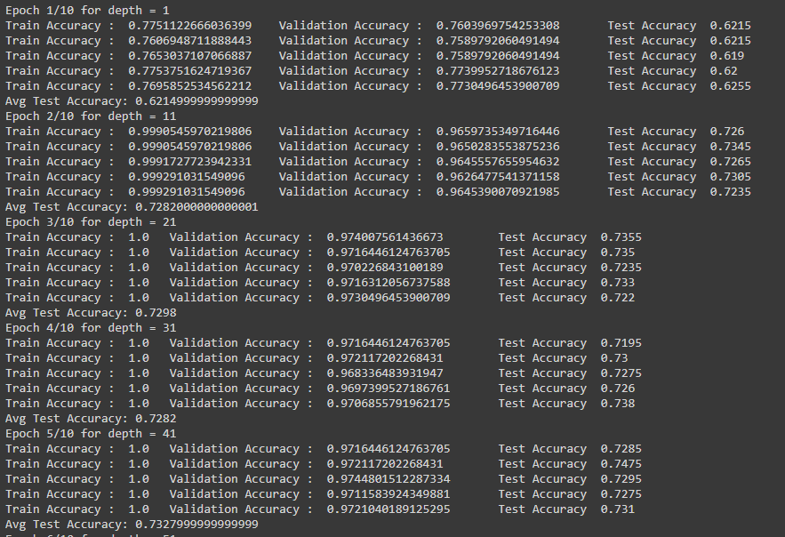
Step 3
n_estimators=fixed
max_depth = variable
Range 1 to 101

Slide 7
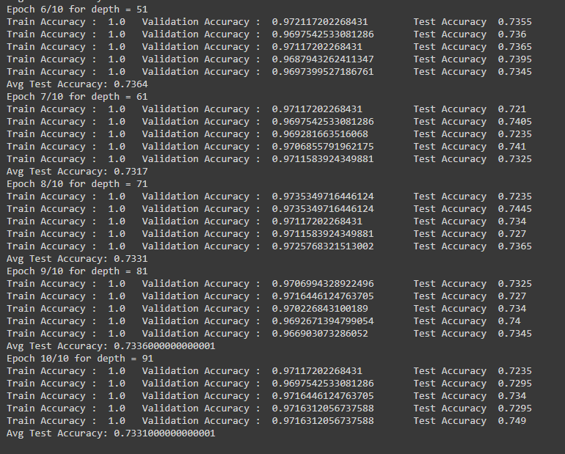
Step 3
n_estimators=fixed
max_depth = variable
Range 1 to 101

Slide 8
Random Forest for Kmer-1

Slide 9
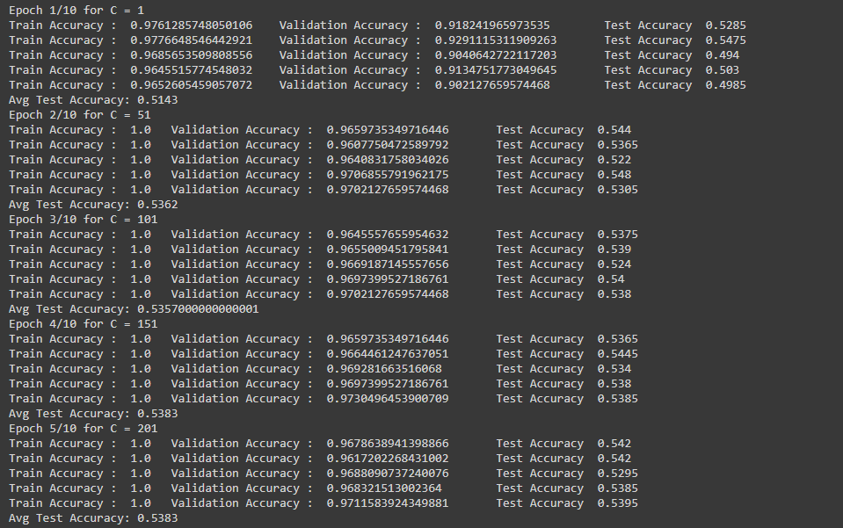
Step 1
n_estimators = variable
max_depth = none
Range 1 to 452

Slide 10
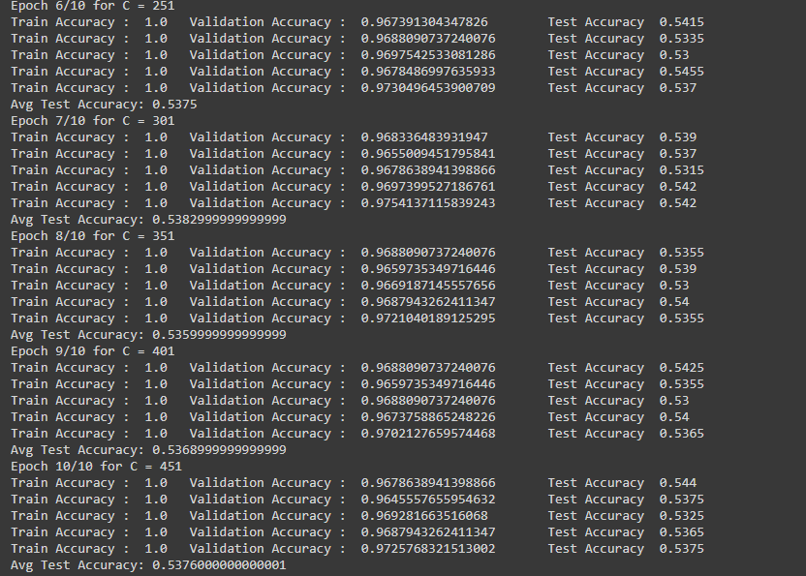
Step 1
n_estimators = variable
max_depth = none
Range 1 to 452

Slide 11
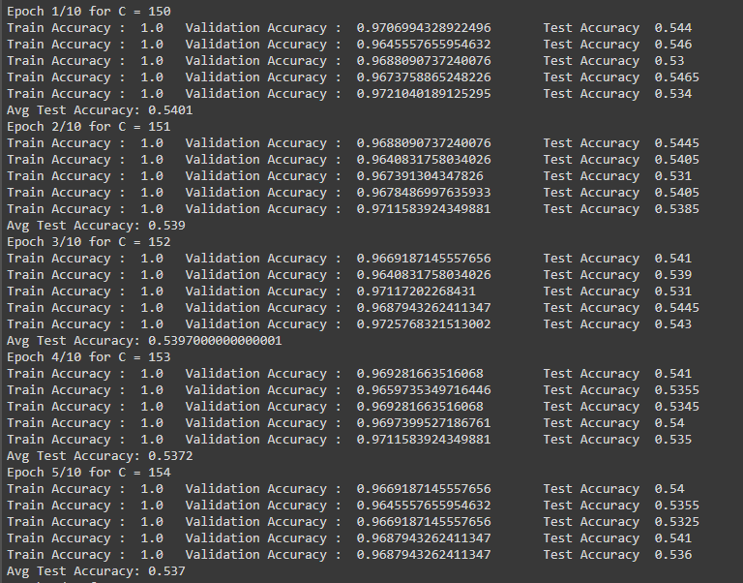
Step 2
n_estimators = variable
max_depth = none
Range 150 to 160

Slide 12
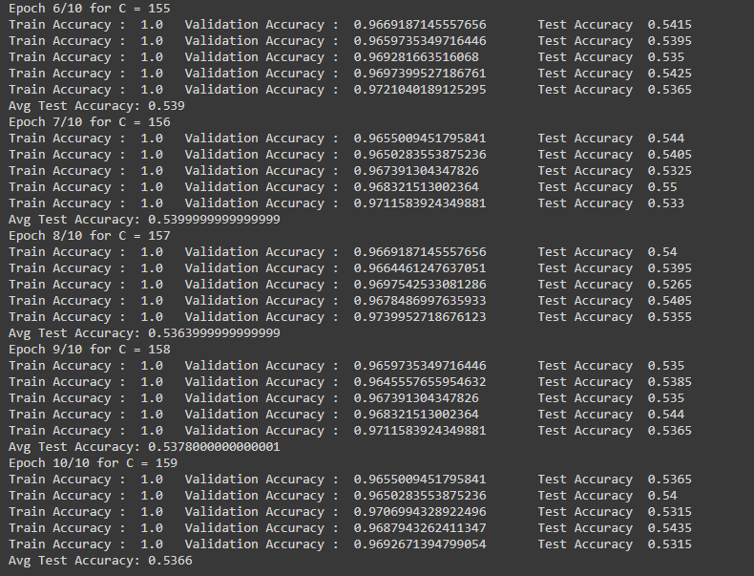
Step 2
n_estimators = variable
max_depth = none
Range 150 to 160

Slide 13
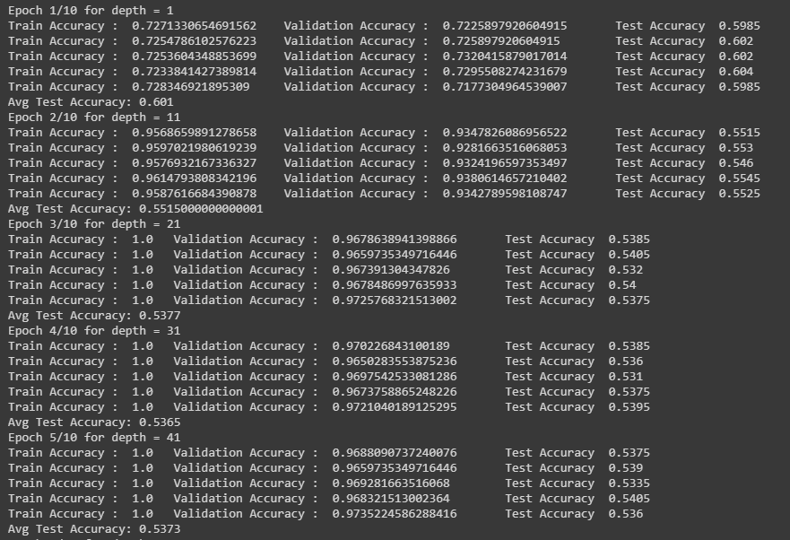
Step 3
n_estimators=fixed
max_depth = variable
Range 1 to 101

Slide 14
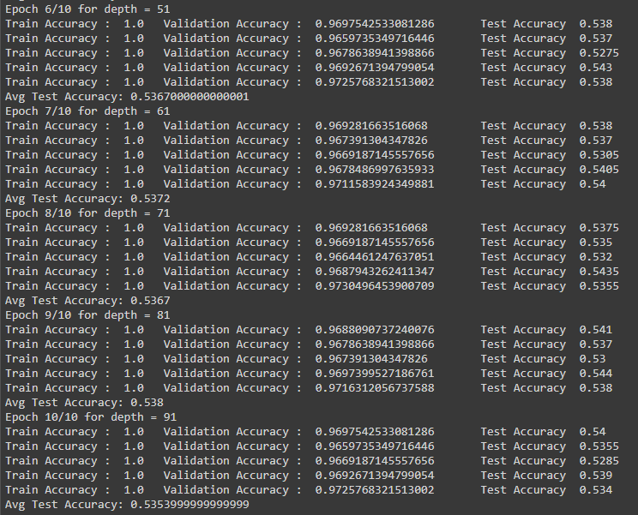
Step 3
n_estimators=fixed
max_depth = variable
Range 1 to 101

Slide 15
Random Forest for ENAC-Len-5 and Kmer-1

Slide 16
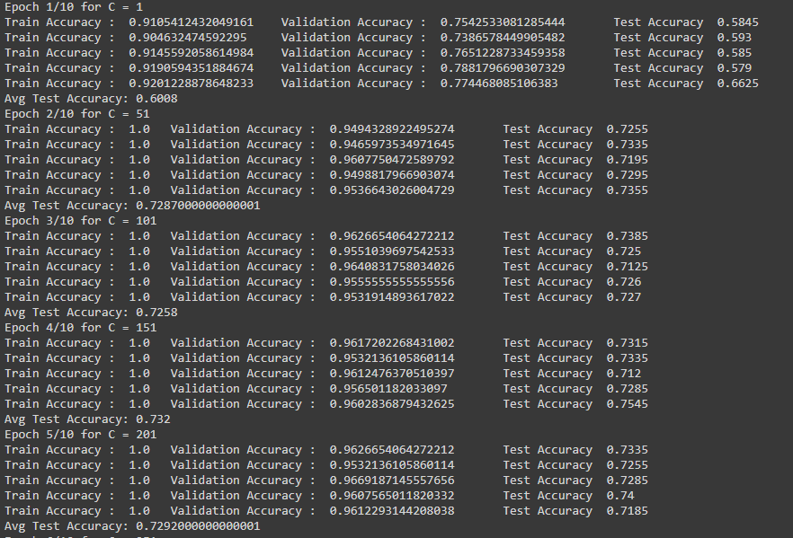
Step 1
n_estimators = variable
max_depth = none
Range 1 to 452

Slide 17
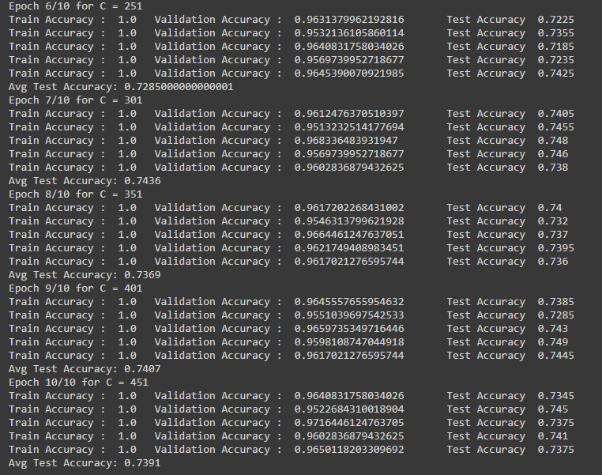
Step 1
n_estimators = variable
max_depth = none
Range 1 to 452

Slide 18
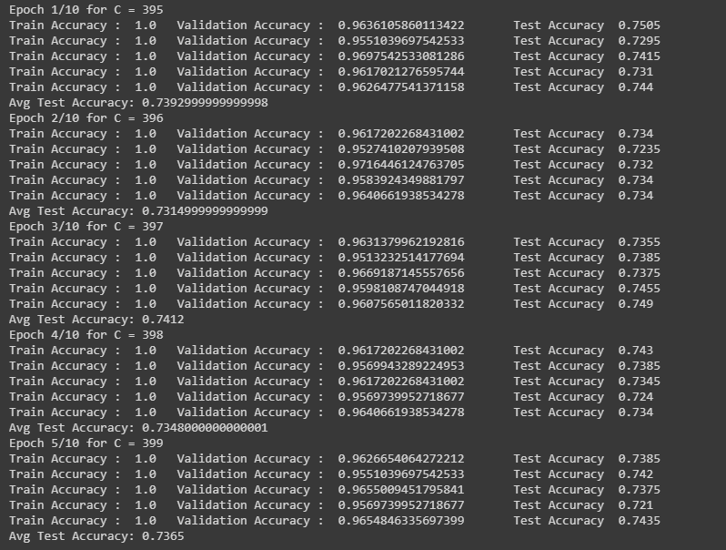
Step 2
n_estimators = variable
max_depth = none
Range 395 to 405

Slide 19
Step 2
n_estimators = variable
max_depth = none
Range 395 to 405

Slide 20
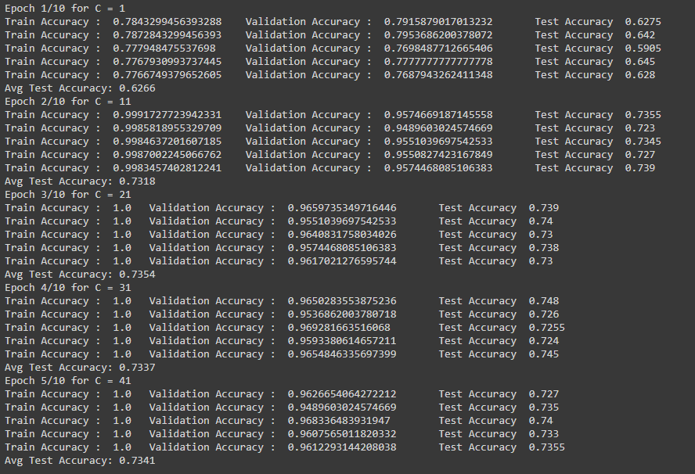
Step 3
n_estimators=fixed
max_depth = variable
Range 1 to 101

Slide 21
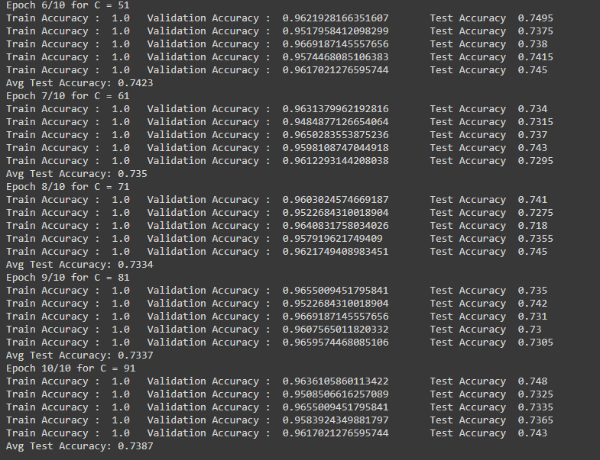
Step 3
n_estimators=fixed
max_depth = variable
Range 1 to 101

